Slide 1

#BestEver
9th
Science-1
Second Unit Test
महाPractice
Maharashtra Board

Slide 2
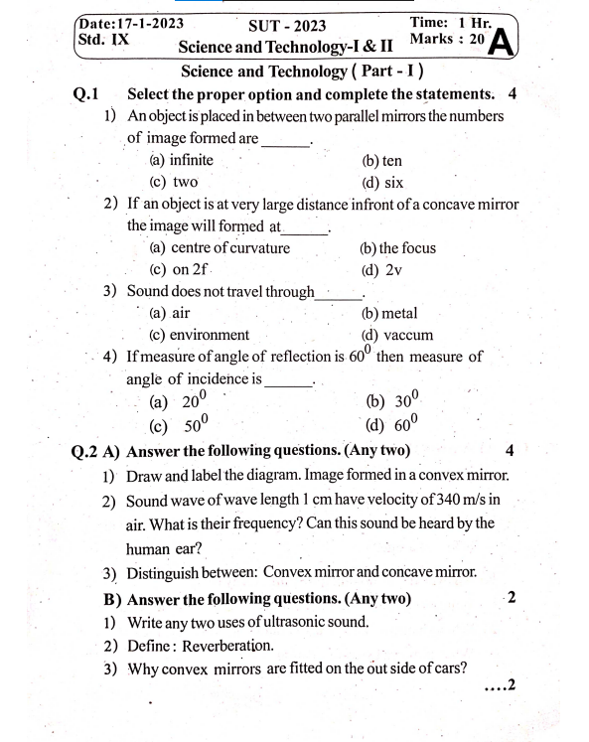
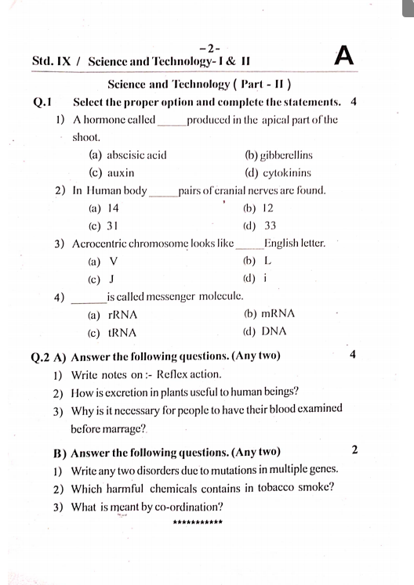
Let’s Solve with
Crystal concept
SUBSCRIBE

Slide 3
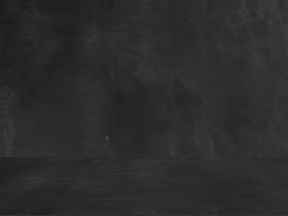
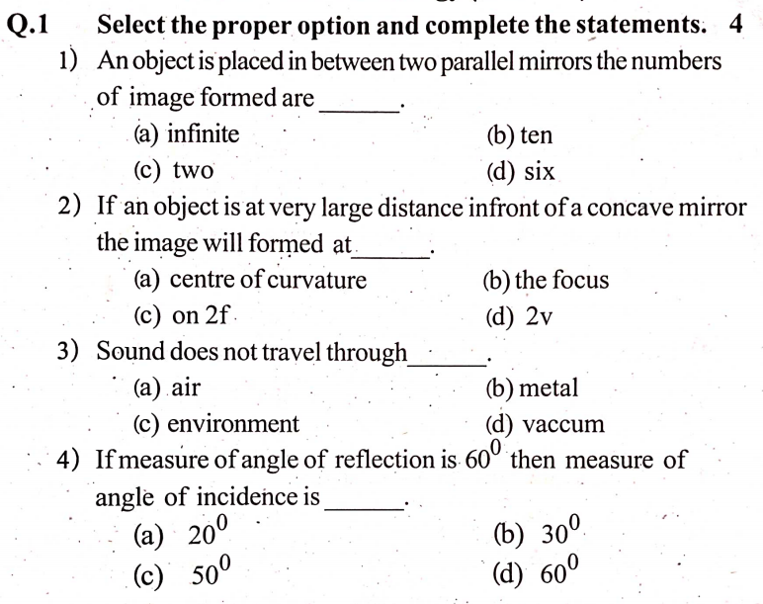
Crystal concept

Slide 4
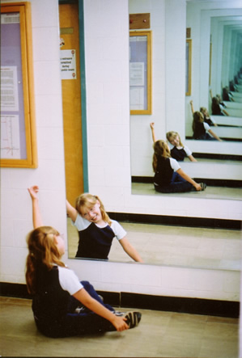
Crystal concept

Slide 5
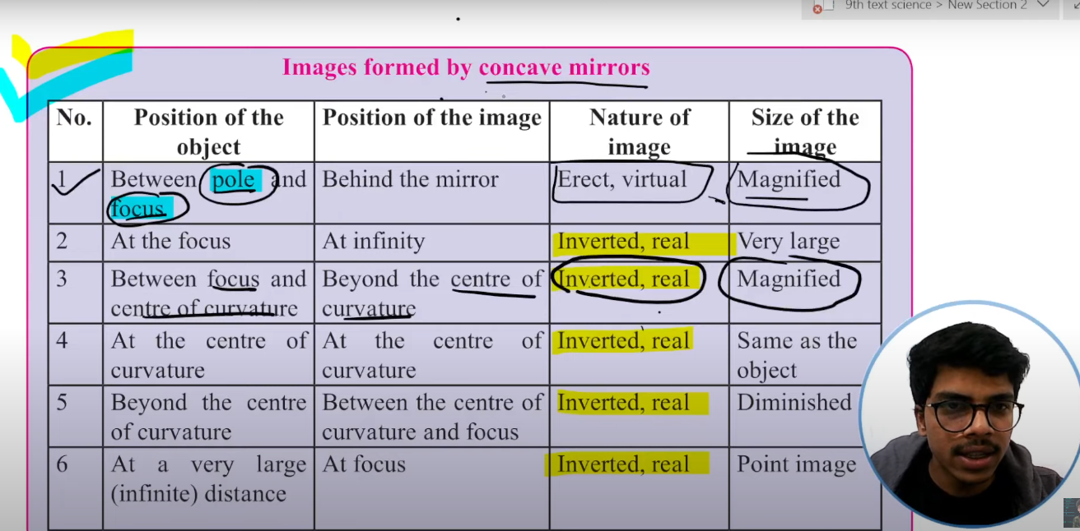

Crystal concept
Infinite
Focus

Slide 6




Crystal concept

Slide 7
Crystal concept

Slide 8
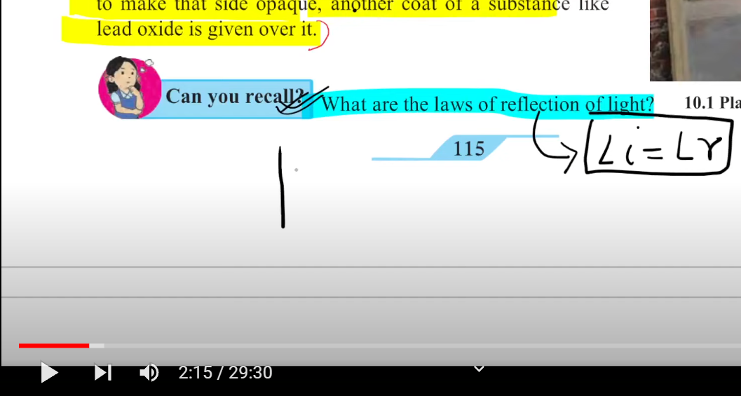
Crystal concept

Slide 9
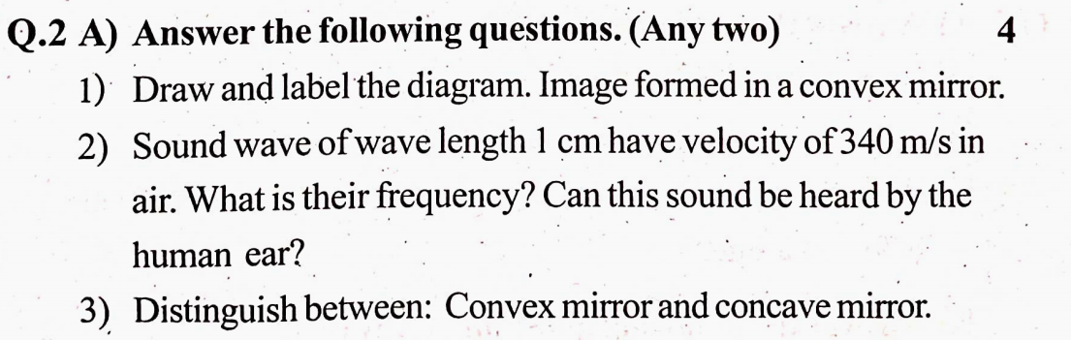
Crystal concept

Slide 10
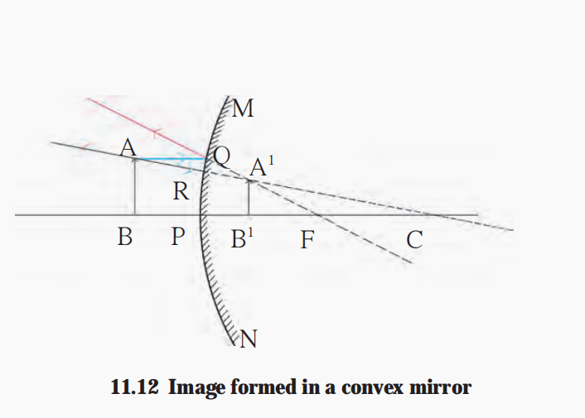
Crystal concept
C

Slide 11
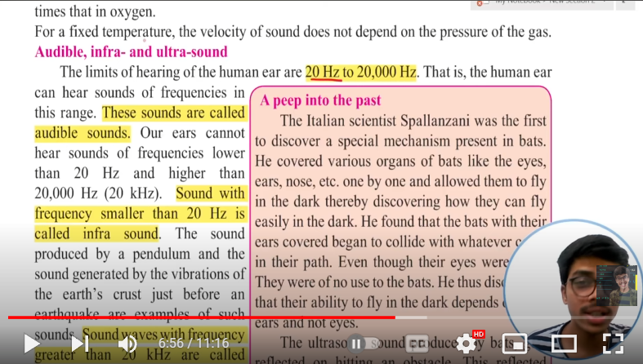
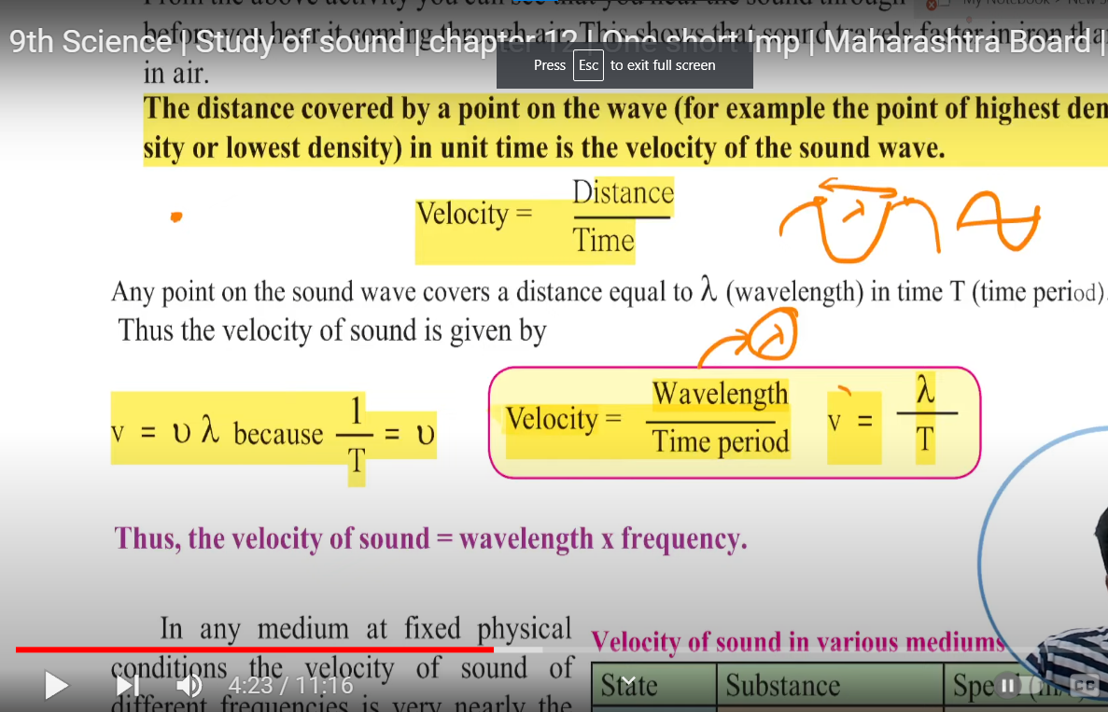

Crystal concept

Slide 12
Crystal concept
Concave Mirror
Convex Mirror
Real and inverted as well as virtual and erect | Always virtual and erect
Magnified, diminished as well as same size as that of object | Always diminished

Slide 13
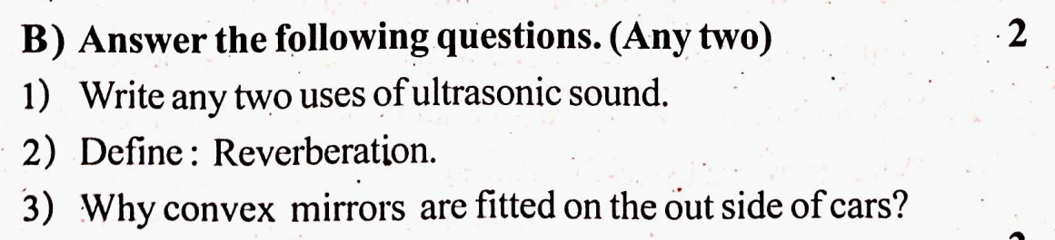
Crystal concept

Slide 14
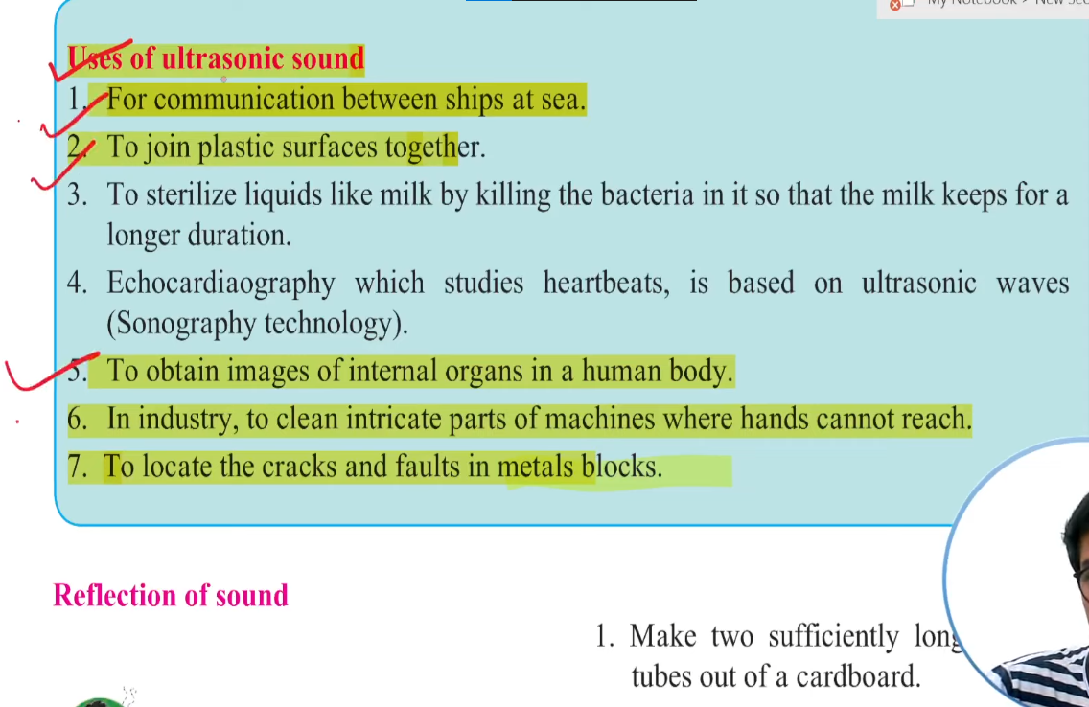
Crystal concept

Slide 15
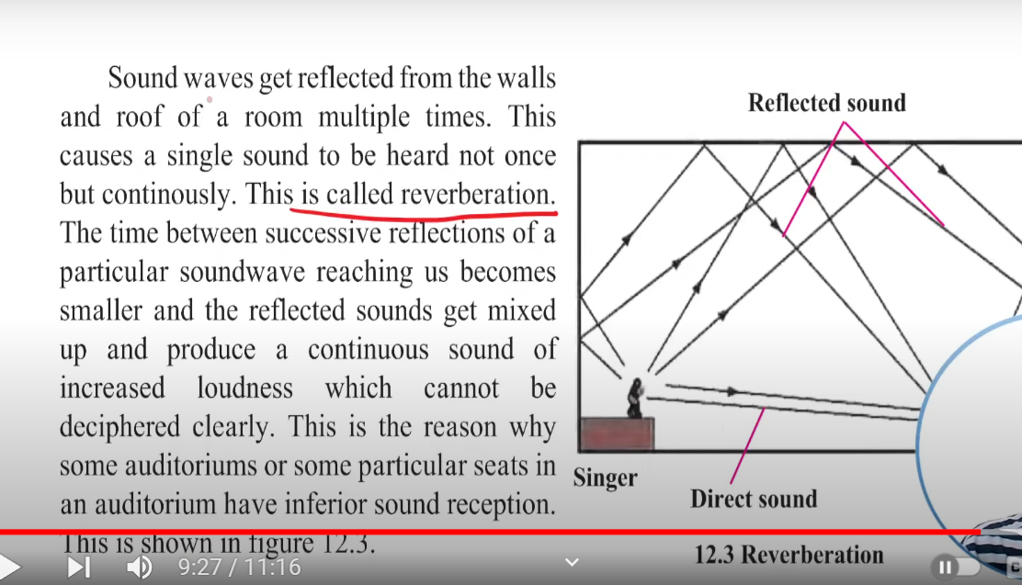
Crystal concept

Slide 16
Crystal concept
1) Convex mirrors have the ability to cover wider field of view by forming diminished and virtual image of the objects.
2) Thus, the mirrors fitted on the outside of cars are convex so that larger view of the road can be observed by the driver sitting in the car.

Slide 17
Crystal concept
SUBSCRIBE

